Slide 1


MedAssist Connect
Get medical Care Early
Welcome to Our Health Care Website.
Our Website is designed to empower you to take control of your health
Our main goal is
To provide an user-friendly website that provide comprehensive first-aid guidance for emergencies.
Our MedAssist Connect will Offer a unique feature allowing users to easily connect with retired or intern medical professionals for personalized suggestions

Slide 2

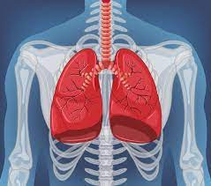
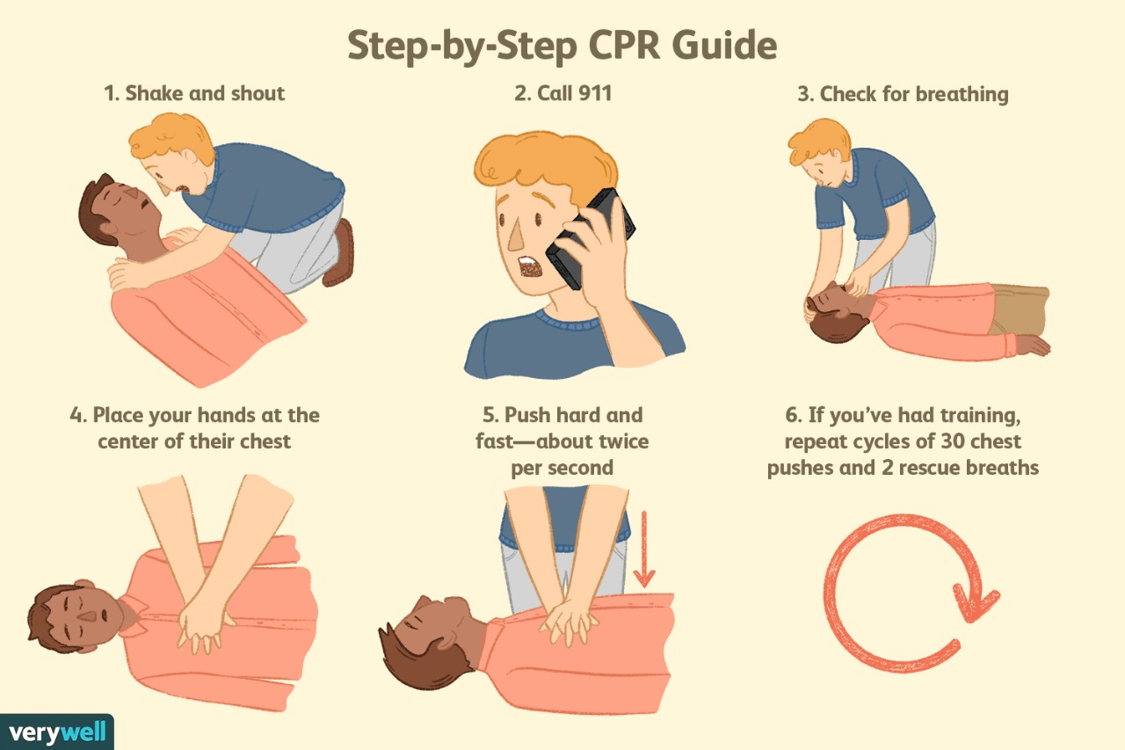
Solutions
Mental Health
A web application mainly focusing on First-Aid guidelines.
It will provide solutions for the wesite users who need first-aid and any other emergency situations.
Physical Health
Experienced physicians draw from there accumulated knowledge while new comers leverage platform like this website to gain valuable experience.
For Example
First-Aid Emergencies
Cardiac Arrest
Electric Stroke
Sleeping Disorders

Slide 3

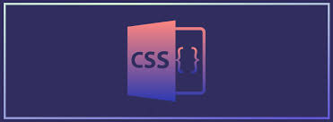



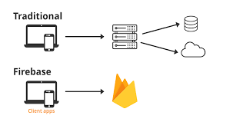
TECHNOLOGIES USED:
The Technologies we have used to create this website :
FRONT-END :
1 . Hyper Text Markup Language ( HTML )
2 . Cascading Style Sheet ( CSS )
3 . Javascript
BACK-END :
1 . NodeJS
2 . FireBase Platform

